Slide 1
The Optimal Product Mix
Deck Assignment 3
Group 3
Sanya Ahuja, Kushaagr Chawla, Tingting Chen, Ruth Ohobi, Pema Singye, Kathy Young

Slide 2
Objectives
To optimize of the usage of shelf space (45 square feet)
To maximise profit per item as well as the total profit
To analyze how three different packs, i.e. singles, 6 packs and twelve packs fare differently in terms of profit
To understand the impact of space per item on profit (in dollars)

Slide 3
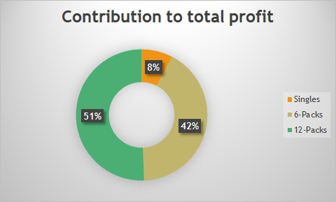
Data Support
This chart depicts the contribution that different products make to the total profit.
As we can see, contribution from 12-Packs is the highest whereas that from Singles is the lowest.

Slide 4
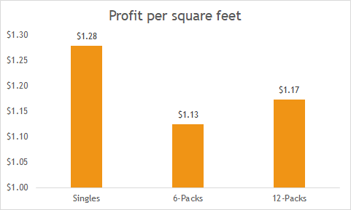
Data Support
This chart depicts the product-wise profit per square foot.
As we can see, it is the highest in case of Singles.
This means that in terms of space, the company makes more money if Singles are produced and sold more.

Slide 5
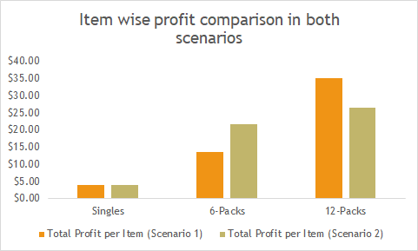
Data Support
This chart compares product-wise profit in scenario one and two.
As we can see, in scenario 1, there is more focus on 12 packs and in scenario 2, there is more focus on 6 packs.
In order to make a decision, other factors such as profit per square foot can be considered.

Slide 6
Recommendations
Look for better alternatives for optimizing each individual item in terms of space taken.
1
Explore different scenarios for finding more profitable arrangement of individual items in the limited space.
2
Focus on customer preferences (in terms of previous sales) in order to decide how the space should be utilized.
Company profit and customer welfare should go hand in hand.
3

Slide 7
Executive Summary
Michael’s Chocolate sells three configurations of chocolate bars and they plan to expand to a national big box store so as to optimize their self pace while maximizing profit.
From the analysis, we deterred that 12 packs had 51% contribution to profit, singles had the highest profit per square feet of $1.28, with the highest amount in the total profit per item.

Slide 8

Thank You

